Slide 1




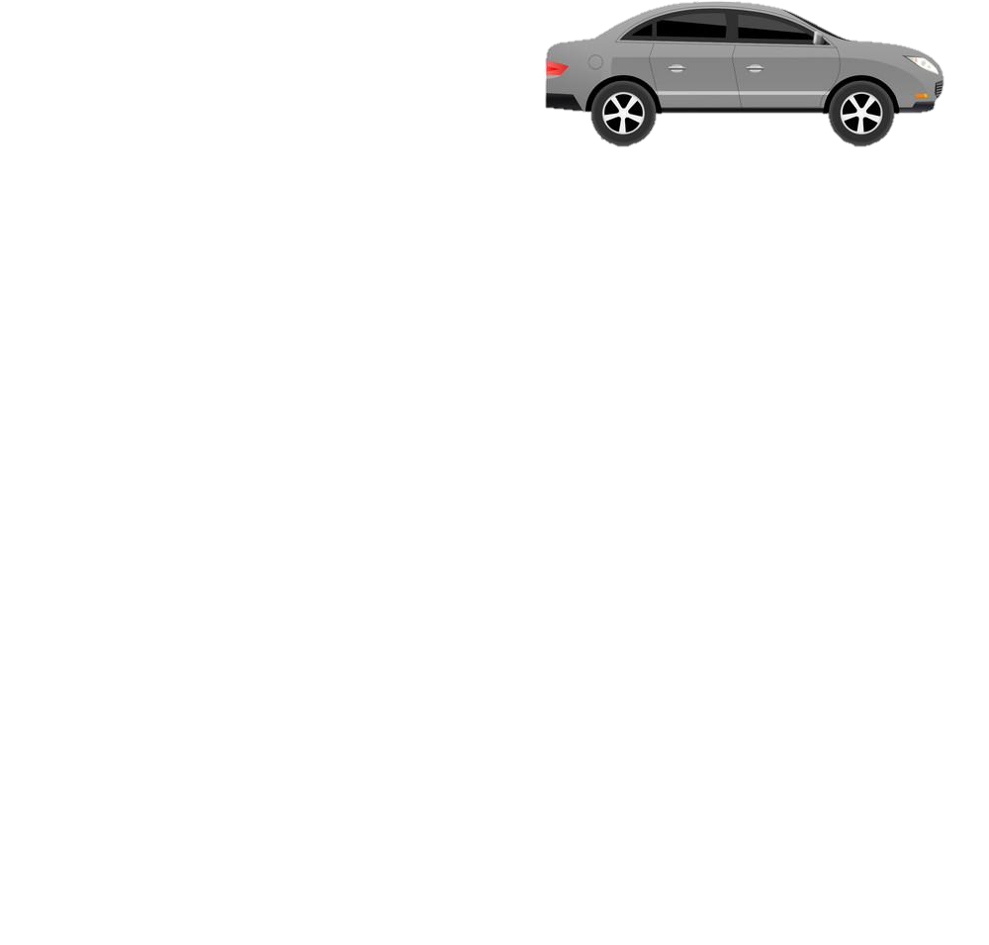
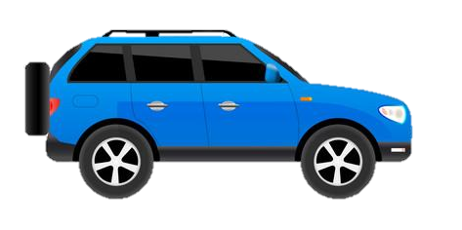
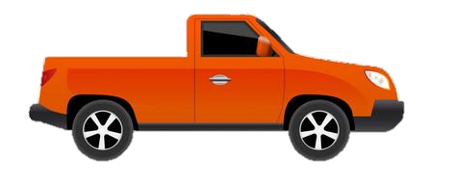

LEARNING JOURNEY – Environmental Studies
PIN BANK
Simply drag a pin to add it to your journey
Destinations – Complete and claim qualification, adding to portfolio/CV/PS 16 application
Destination Two – Specific Environmental or landscaping qualification at a Alternate provider or College
Students complete a case study of one of the actives that have taken place
Teamwork
& Comp
Destination Three – Complete a level 2 Environmental qualification
Complete assessment booklet
Students update workbook and select images for portfolio, complete discussions around units.
Complete assessment booklet
Students update workbook and select images for portfolio, complete discussions around units.
LO1 – Mark out the line of a fence
Health and Safety Unit
Unit booklets complete and handed in for marking.
Timber fencing
LO2 Erect posts for timber fencing
LO3 – Be able to attach trails
Complete assessment booklet
Students update workbook and select images for portfolio, complete discussions around units.
The red box:
These road work boxes can be used to highlight a particular task, or link parts of the journey to the national curriculum.
Just copy and paste when needed and drag to map position, editing position of pin if necessary. Type over this text.
Footpaths &
surface
LO1 Be able to lay a footpath
LO2 be able to maintain a footpath
Complete assessment booklet
Students update workbook and select images for portfolio, complete discussions around units.
LO1 – be able to plant wooded areas
LO3 – Weed and maintain grassland area
LO2 – Maintain wooded areas
Woodland management
LO1 – Identify and prepare area for grassland
Complete assessment booklet
Students update workbook and select images for portfolio, complete discussions around units.
LO2 – Seed and maintain grassland
Tasters:
Pre-course baseline. Discussion of any existing skills covering all units. Any existing knowledge or skills
Complete Health and Safety unit booklet and hand in for assessment
CAR PARK
Grassland Management
Tasters & Health & Safety
Why not
Start work on Unit booklet for Health and Safety
Tasters:
Tasters for fencing, slabbing and woodland management. Students are introduced to basic good practices and recommended practices.
Y10 Practical Skills for Environmental and Conservation
Karl Davey

