Slide 1






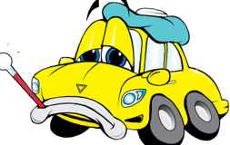
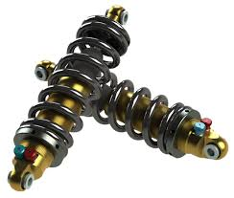
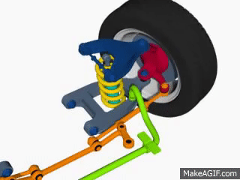
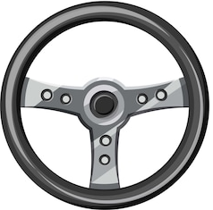


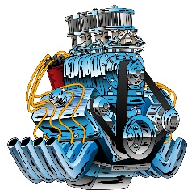



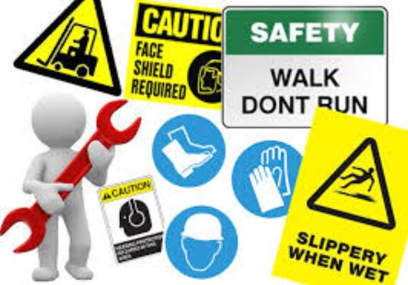
Learning Journey - Motor Vehicle Studies Level 1
Progression on to the Level 2 qualification at another Alternative provider/College
Complete and claim qualification, adding to portfolio/CV/PS 16 application
As well as Accredited units; Workshops are on offer throughout the courses including;
Knife Crime workshop
Sexual Health workshop
Mental Health Awareness
Smoking Workshop
Destination Two – Options to look into an apprenticeship
Developing knowledge and understanding of Vehicle Braking Systems
Learning the purpose of engine cooling and what it’s function is.
Discovering the importance of correct maintenance and lubrication of key engine components
The Diploma Segment
The Certificate Segment
Vehicle Braking Systems
Engine Cooling & Lubrication
Upon completion of the ‘Award’ and ‘Certificate’ segments of the course; there is an option to complete the ‘Diploma’ segment which is the final three units of the course and are optional units for the student to tailor their course towards areas of specific interest.
Understanding the components and maintenance of steering mechanisms
Learning the installation process and maintenance of car suspension
Discovering the different types of suspension and understanding the use of each type.
Steering
Dismantling and assembling engine on a stand
Learning the parts of an engine and what their function is.
Suspension
Safety Procedures – Manual handing tasks; improving knowledge of tools, their function and their purpose.
Spark ignition
Learn the 4 Stroke Cycle and become familiar with using industry tools/machinery
Development of students understanding of ‘a live workshop’ including demonstrations and observations of tools being used by industry experts.
The Award Segment
Taster Sessions
Introduction sessions using feedback from students area of interest to help decide which route/course to take; Motorbike Mechanics, Car Mechanics, bicycle mechanics…
PPE & Competency
Health & Safety
Taster Sessions
Award segment is the first of 2 qualifications offered; with potential for an optional third qualification in the form of a Diploma - subject to completion of ‘Award’ and ‘Certificate’.
Initial sessions include tours and ‘meet&greet’ with course tutors of our Mechanics AP’s such as Carworx and AXLR8…
Mechanics Motor Vehicles Studies Level 1
Harry Alcott

