Slide 1


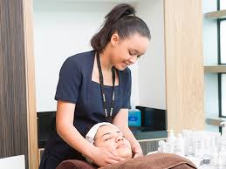



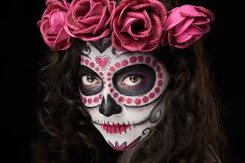
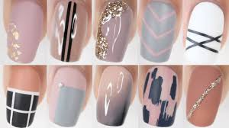
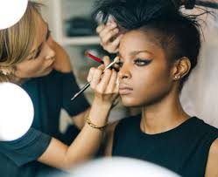


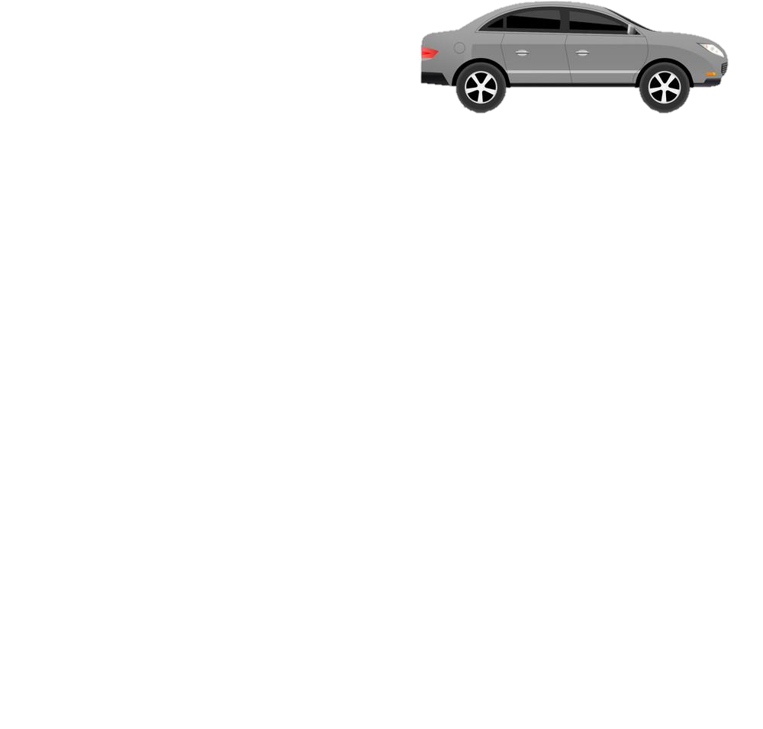
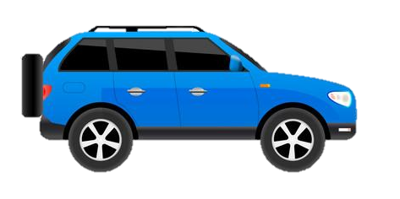
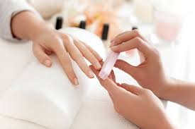
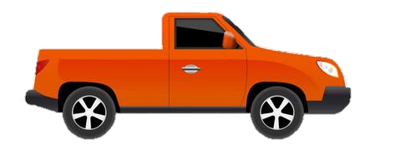



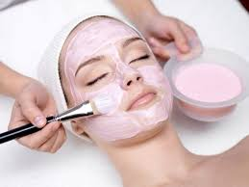
LEARNING JOURNEY – Beauty Therapy
PIN BANK
The red box:
These road work boxes can be used to highlight a particular task, or link parts of the journey to the national curriculum.
Just copy and paste when needed and drag to map position, editing position of pin if necessary. Type over this text.
Simply drag a pin to add it to your journey
Progress onto Level 2 Beauty Therapy qualification
Complete and claim qualification, adding to portfolio/CV/PS 16 application
Level 1 Diploma in an Introduction to the Hair and Beauty Sector
Look into becoming a salon assistant
The red box:
These road work boxes can be used to highlight a particular task, or link parts of the journey to the national curriculum.
Just copy and paste when needed and drag to map position, editing position of pin if necessary. Type over this text.
Level 1 Certificate in Hairdressing and Beauty Therapy (Beauty Pathway)
PHOTOGRAPHIC MAKE-UP
NAIL ART
FACE PAINTING
SALON RECEPTION
Trips to tradeshows, wholesalers, salons and spas throughout
Level 1 Certificate in an Introduction to the Hair and Beauty Sector
WORKING WITH OTHERS
HEALTH & SAFETY
MAKE-UP
PEDICURE
Level 1 Award in an Introduction to the Hair and Beauty Sector
SKIN CARE
PROFESSIONAL IMAGE
MANICURE
This Vocational Taster provides opportunities for learners to develop beauty skills and how to use them effectively
Introduction sessions using feedback from students area of interest to help decide which route/course to take
CAR PARK
INTRO TO THE BEAUTY SECTOR
Why not
TASTER
SESSIONS
ASDAN
Beauty Therapy – ASDAN / City & Guilds
Holly Quinn

